Slide 1
Let’s meet each other!
Have look at your “bingo” sheet
Find someone who can address the criteria in each box.
Don’t use each person more than once.
No group huddles!!
Yell bingo when you get all in a row
Prize will be given – might not be for fastest though!!

Slide 2


Welcome to

Slide 3
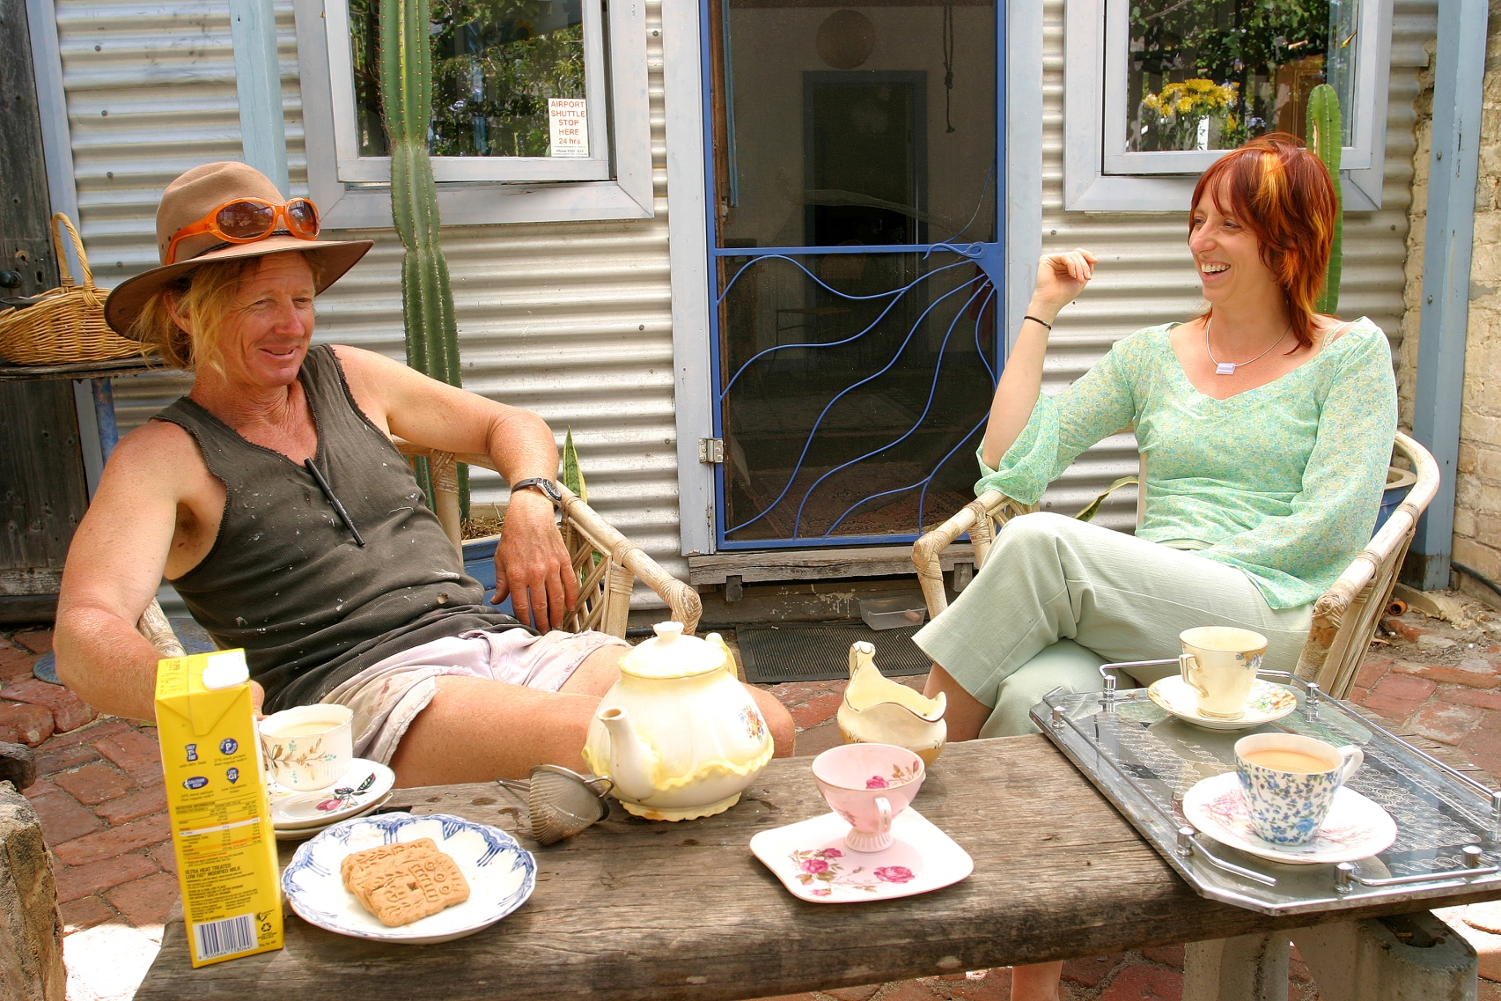
What about Shani & Tim?

Slide 4
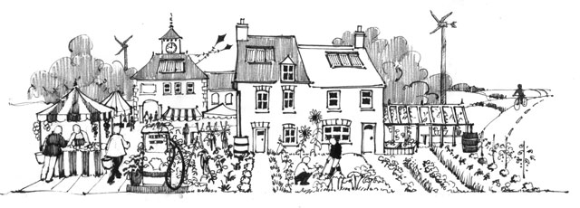
Transition Town Influence

Slide 5
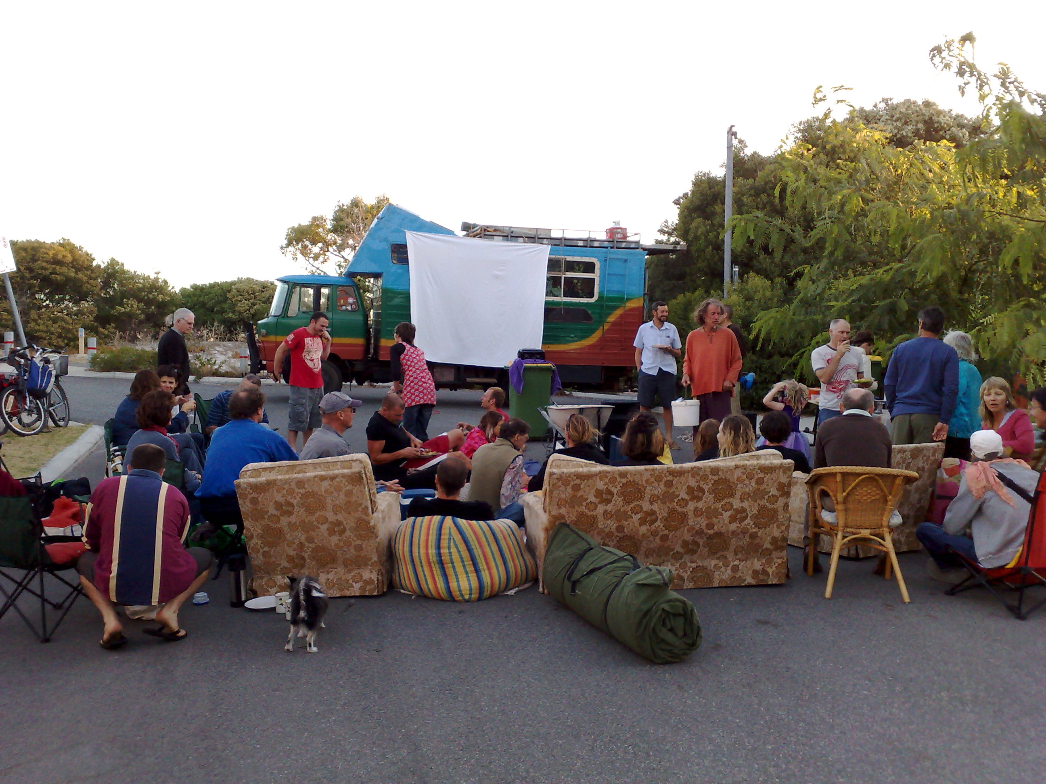
Hulbert Street Movies

Slide 6

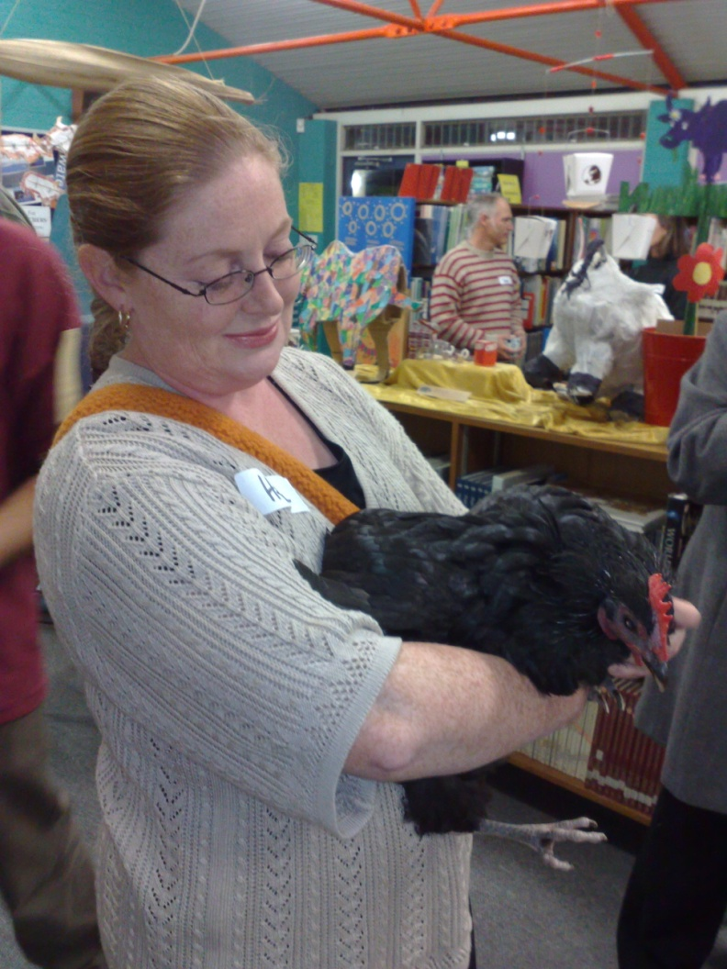
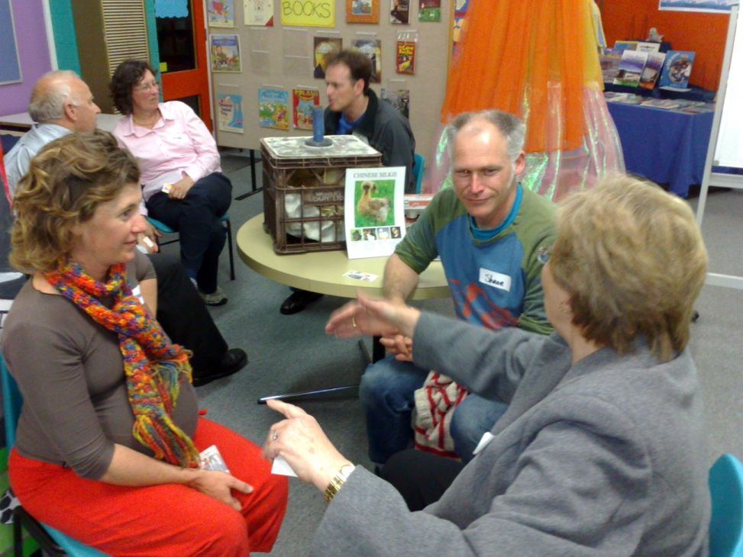
Notes:
SHANI Living Smarties – once a month
Get together share what been up to
Hear from a local
Eg waste, body care, office, chooks, preserving
Works to support post LS and encourage people to do a course
Those done course more proactive attitude

Slide 8
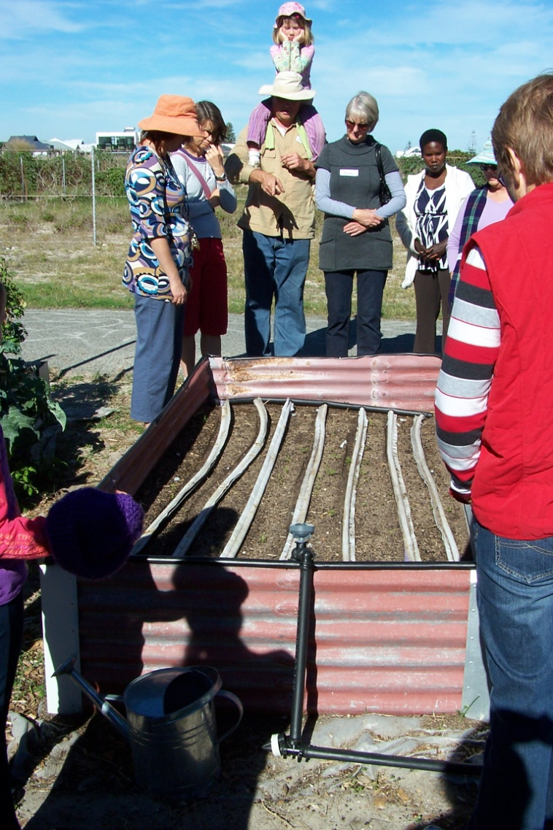
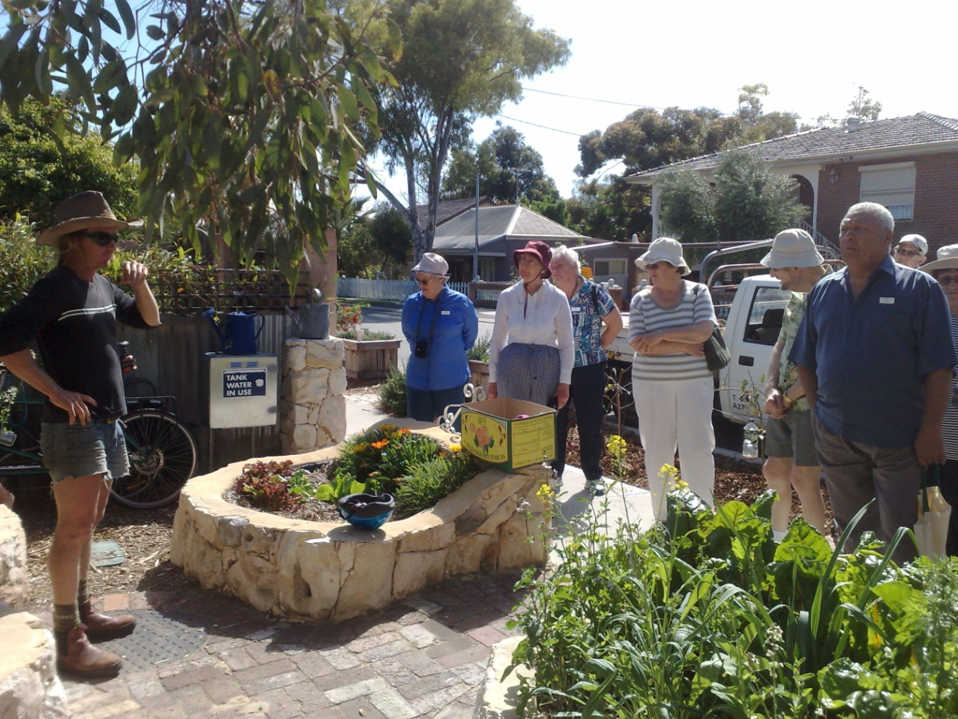
Hulbert Street
Monthly Tours

Slide 9
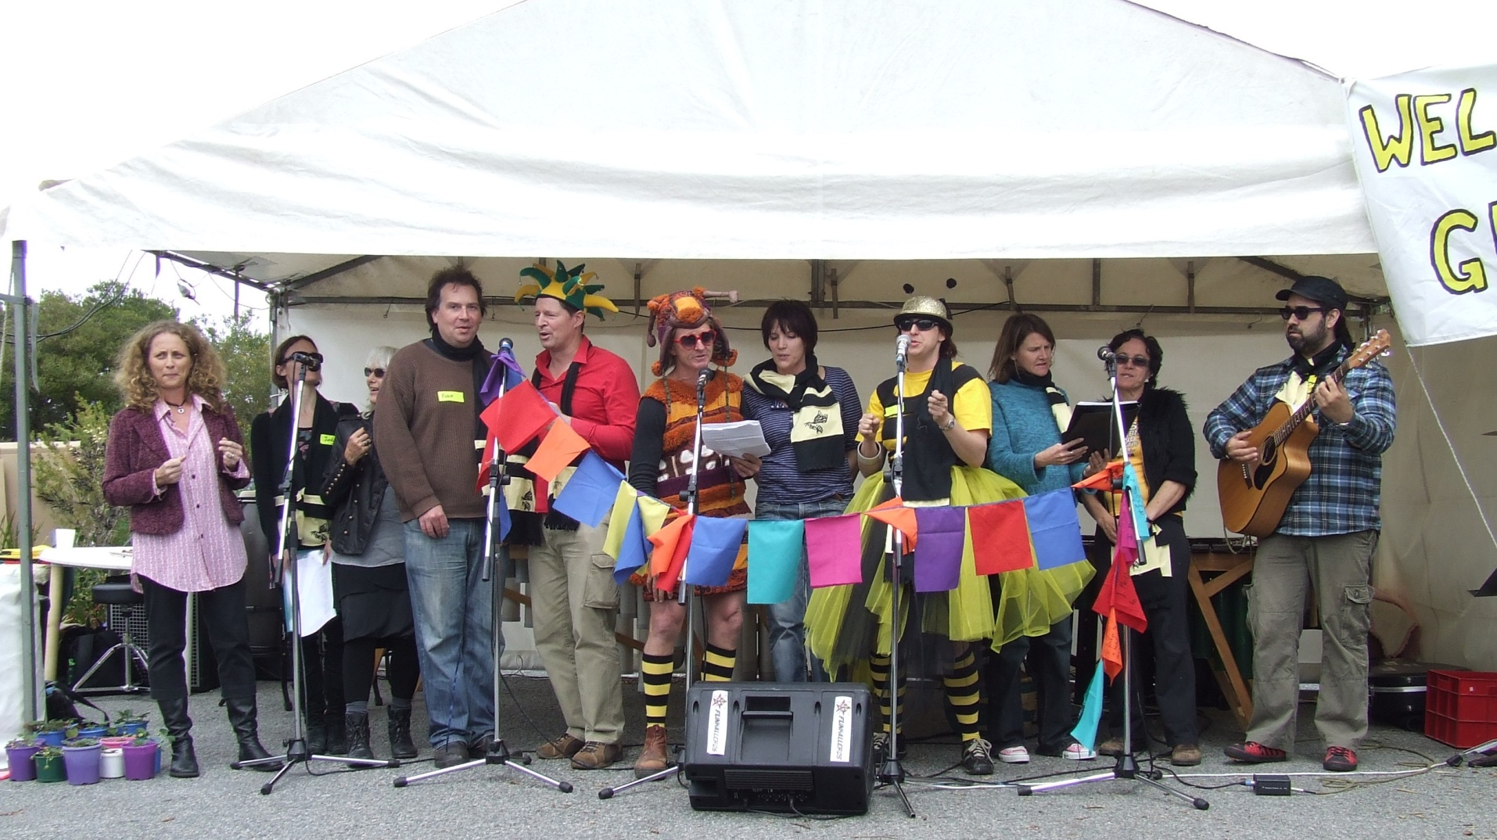
Hulbert Street Choir

Slide 10
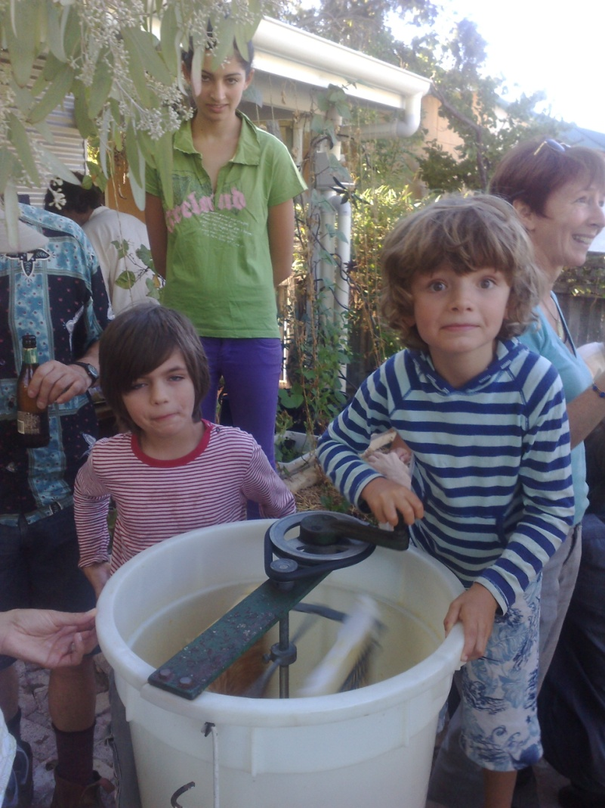
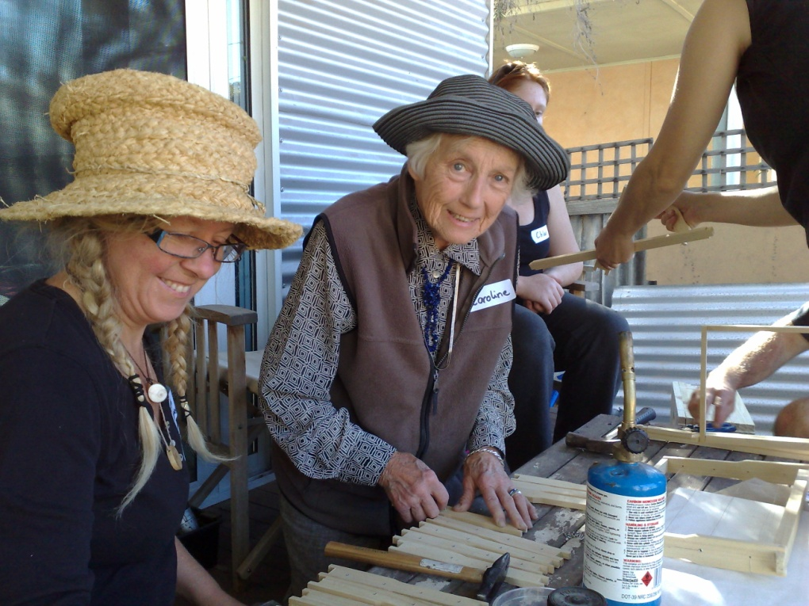
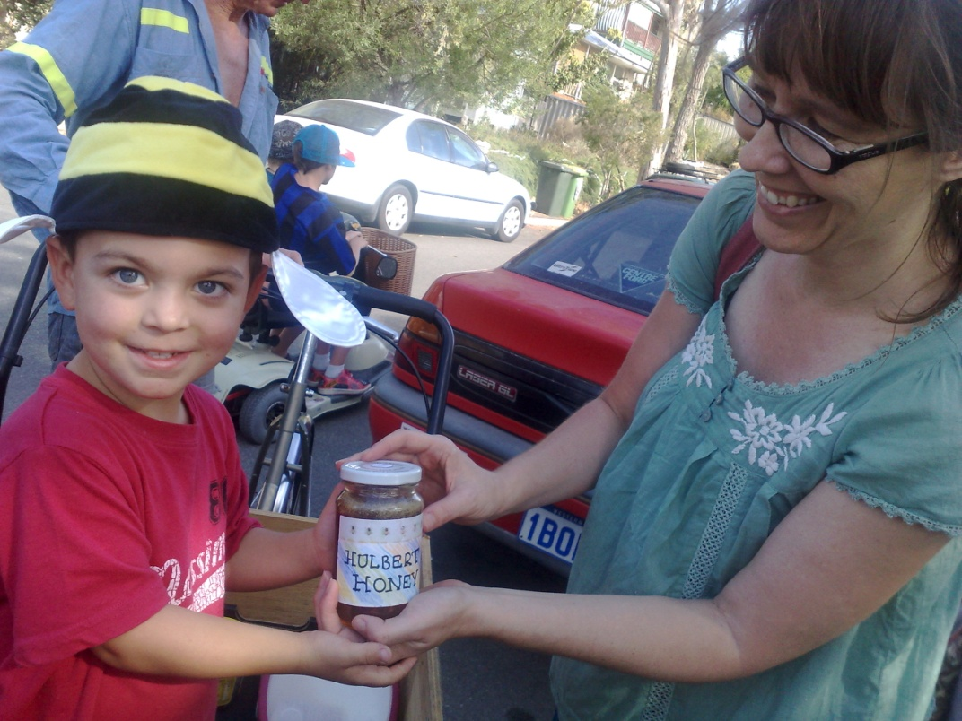
Hulbert Honey

Slide 11
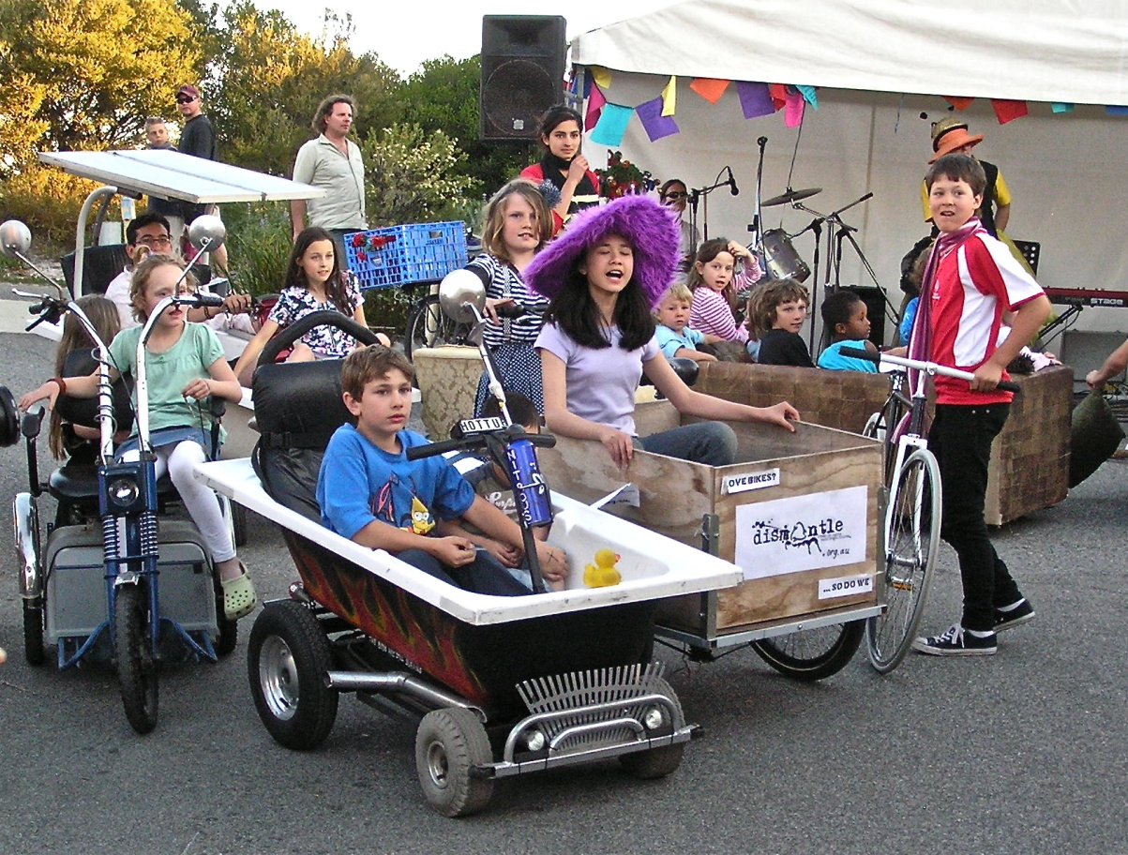
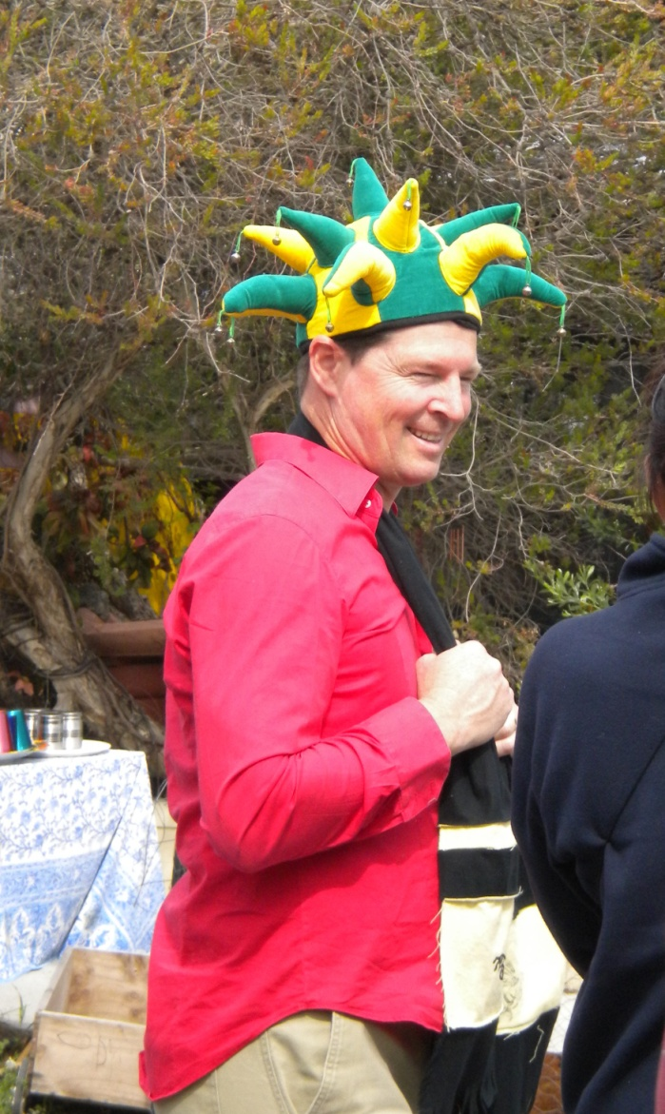
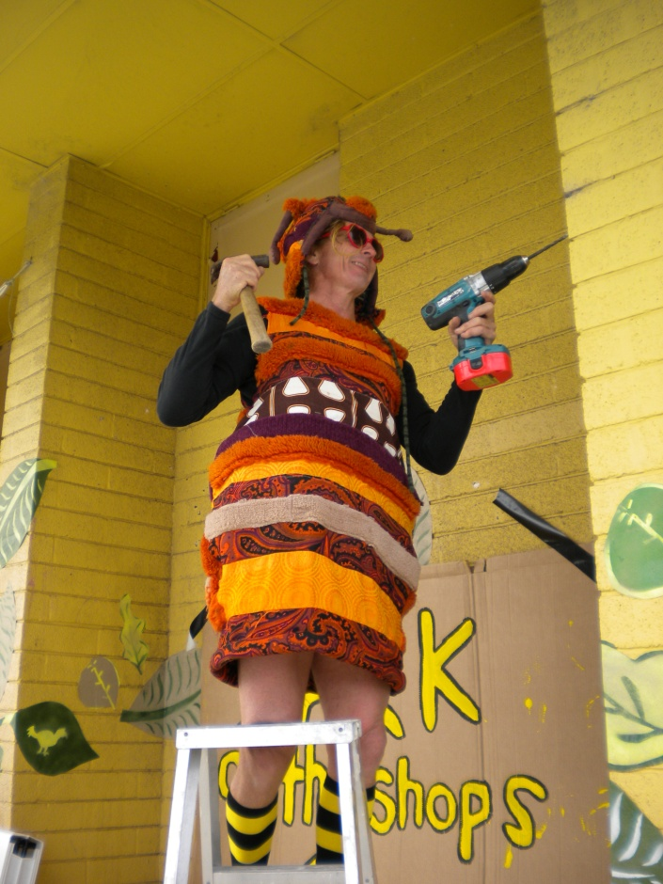
HULBERT
STREET
Sustainability Fiesta

Slide 12
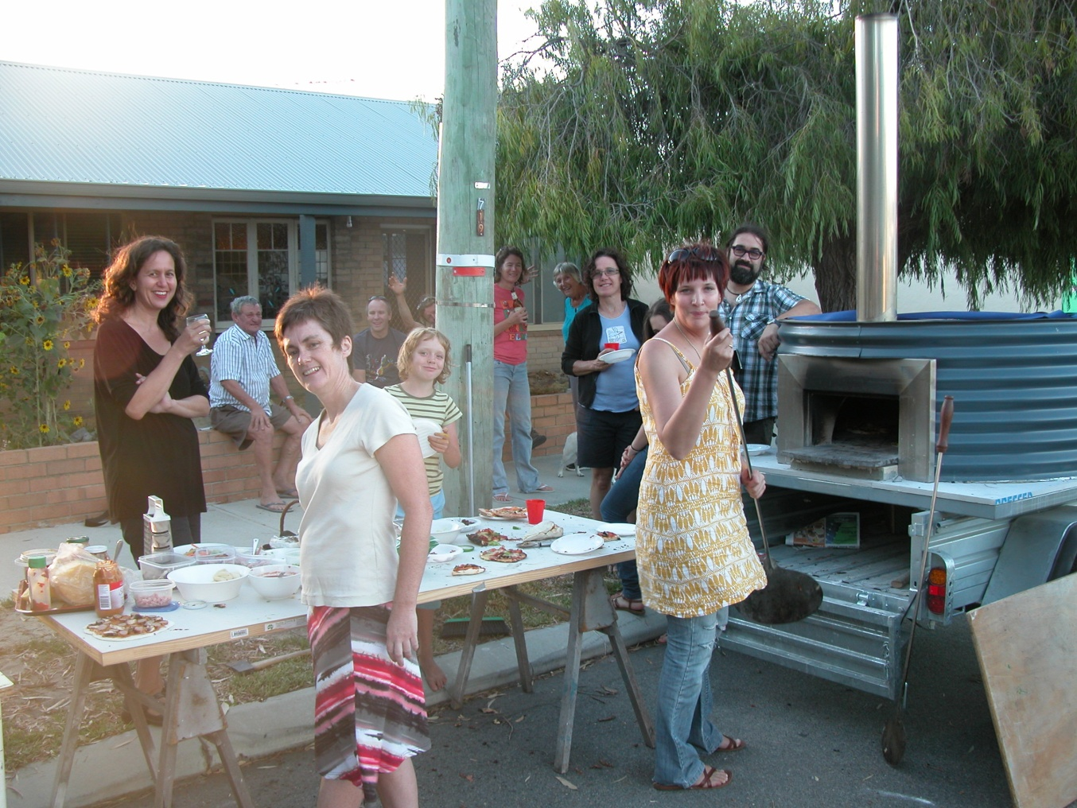
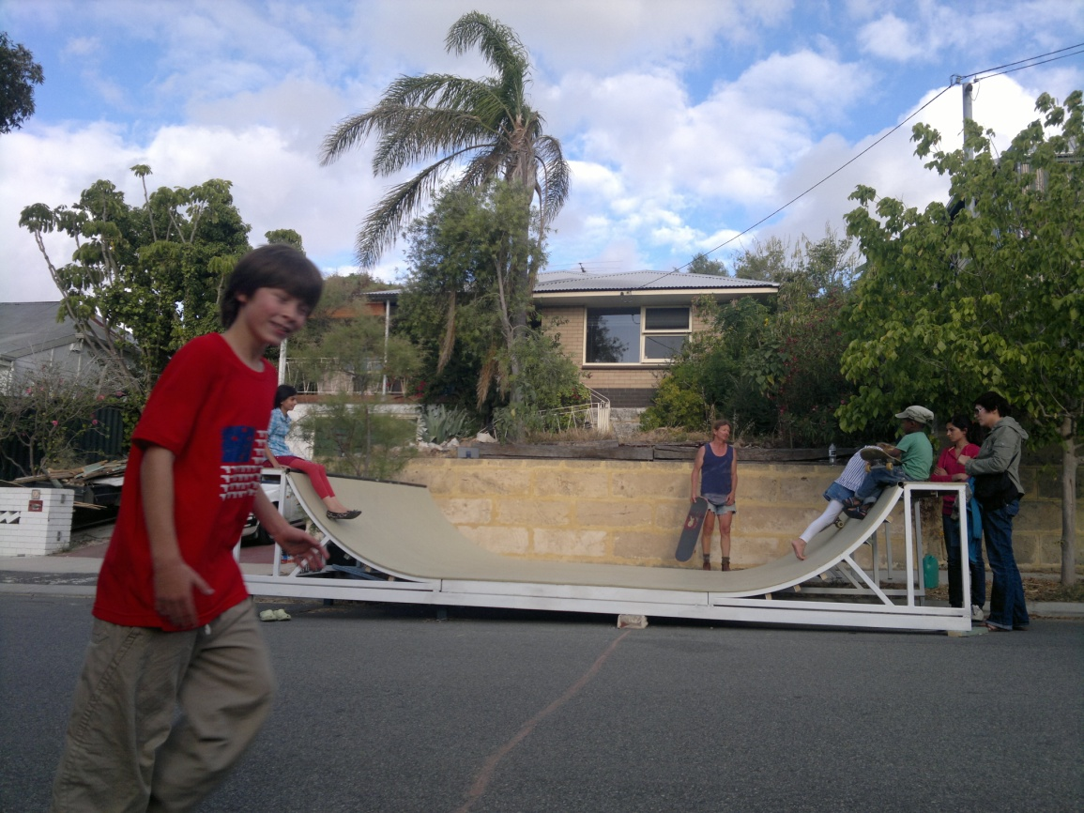
Shared
Resources

Slide 13
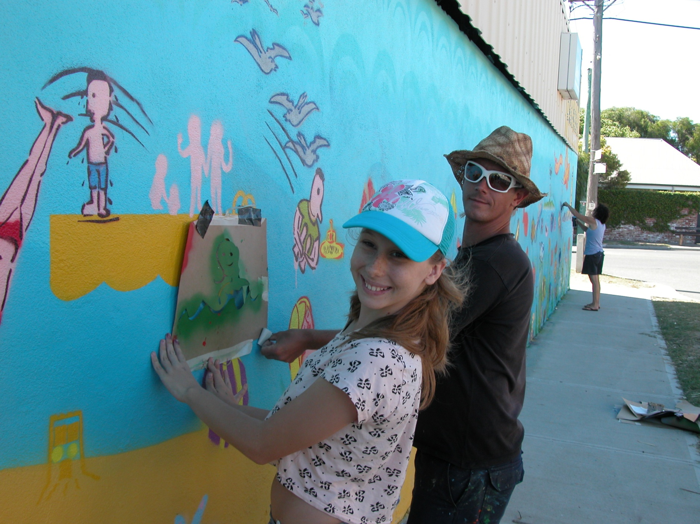
The Hulbert Street
Mural Project

Slide 14
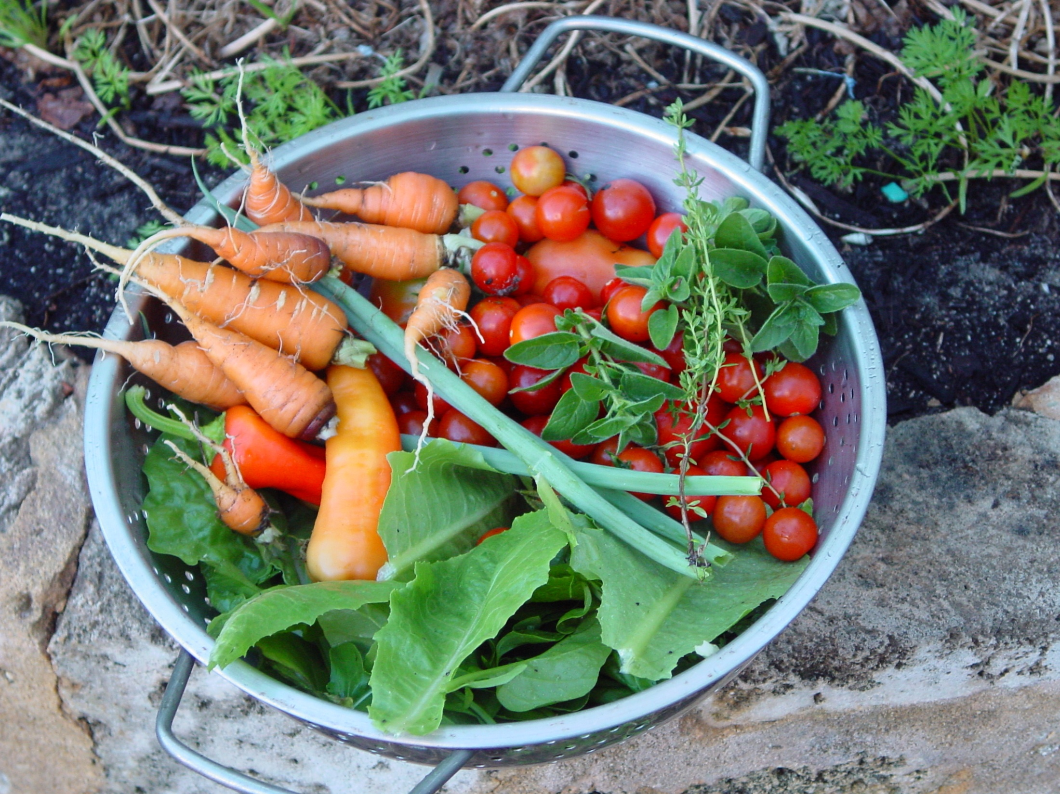
Extending Hulbert Street
Freo Farm
(On the South Fremantle Tip Site)

Slide 15


Slide 16
What is Living Smart ?
Living Smart is a community environmental education program that empowers participants with the knowledge and skills to take action to improve the sustainability of their homes and their community.
www.livingsmart.org.au
Notes:
Living Smart is different to other environmental education programs in that it does not focus on a single environmental issue but adopts a wholistic approach by looking at environment, lifestyle and community.
It also includes a winning formula to facilitate behaviour change both in the home and community.
What makes Living Smart so unique is that it is a thoroughly researched and evaluated program and has been formed through a unique partnership. Its strength lies in the evaluation process and how the results over time have improved the program and its delivery. The Living Smart program has been developed from the findings of 9 trials.

Slide 17
Living Smart Partnership
Living Smart was developed through a strong partnership between:
City of Fremantle & The Meeting Place
Murdoch University
Southern Metropolitan Regional Council,
Now governed by:
Be Living Smart Inc
Notes:
The Living Smart partners have pooled resources, time and effort to produce the Living Smart Kit so that other organisations, community groups, individuals and businesses can take Living Smart into their own home, community and workplace.
In running this program, we acknowledge the Living Smart partnership and thank the partners for providing us with the resources and materials to run this exciting initiative. Without their time, resources and commitment, we would not be able to offer this course.

Slide 18

Sustainability
Notes:
Before we even begin – it is useful to look at what people think sustainability means
Eg Sustainable accommodation in a seaside garden – so what?
Placemat activity – record individual ideas first, then come to a consensus as a group about what sustainability means.
Note your consensus in the middle
Share your group definition with the larger group.
(Don’t worry if groups don’t reach consensus – the discussion could be just as valuable!)
Discuss and comment

Slide 19
What is sustainability?
Living in a way that meets the need of the present without compromising the ability of future generations to meet their own needs.
Finding a balance between environment, economy and society.
Notes:
These are a couple of well established definitions

Slide 20
Notes:
If you look at the paper it sometimes feels like this

Slide 21
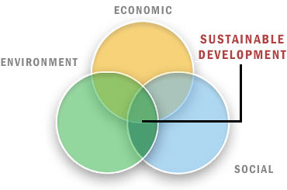
Notes:
This is what we are aiming for
And this is why we cover all aspects in this course too.

Slide 22
PLANET
PEOPLE
PROFIT

Slide 23
Why do we want to achieve sustainability?
Escalating consumption of limited resources Climate change Land degradation Salinity Air, water and land pollution Loss of biodiversity Loss of forests Over population exacerbating impacts Inequality of wealth Inequality of human rights
Notes:
Why did you come? Why are we interested? There are so many reasons to be interested in a more sustainable world.
Read list - think about own interests and concerns
If time or inclination
BIODIVERSITY ISSUES IN WA
Rate of loss in Australia is unprecedented
Lost of 75% rainforest
Lost 40% total forest area
70% of all vegetation removed or significantly modified
As much land cleared since 1945 compared to 150 years earlier
(Source UNEP State of the Environment report – Asia Pacific Outlook, 2001 http://www.rrcap.unep.org/reports/apo2/Past%201.pdf )
Western Australia
23 known species presumed extinct
547 threatened
(CALM, Towards a Biodiversity Conservation Strategy for WA 2004)
http://www.calm.wa.gov.au/haveyoursay/pdf_files/biodiversity_draft_lores.pdf
Australia Endemic Species
85% flowering plants
84% mammals
45% birds
89% reptiles
93% frogs
85% fin fish species
Dept of Environment and Heritage website 2005 http://www.deh.gov.au/biodiversity/threatened/
WA Endemic Species
Southwest of WA is one of 25 International Biodiversity Hotspots, the only in Australian
79% of south-west of WA’s flowering plants, ferns and cycads are endemic
34 out of Australia’s 305 mammals are endemic to the southwest
(CALM, Towards a Biodiversity Conservation Strategy for WA 2004)
http://www.calm.wa.gov.au/haveyoursay/pdf_files/biodiversity_draft_lores.pdf

Slide 24
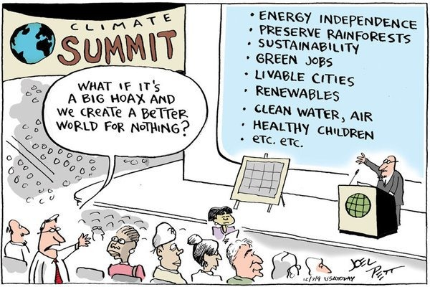
Notes:
Being seen as more and more important by people

Slide 25
Ground Rules
Keep it positive
Cooperate in good faith
One person at a time
Keep the discussion focussed
Respect everyone’s opinion
Allow and give no put downs
Ask if you don’t understand
Let everyone have a go
Keep to a time
Notes:
Everyone to read to selves
Ask for comments or responses
Tim will talk to – Keep it positive
Shani to power of listening to each other, not letting one person dominate (sometimes may have to save questions)

Slide 26
So how will it work?
Participants’ Guide and topics –
Simple Smart Living
Waste Smart,
Water Smart,
Smart Gardens for Biodiversity
Smart Gardens for Productivity,
Power Smart,
Move Smart,
Health Smart You,
Health Smart Home,
Community Living Smart
Notes:
Refer people to page 4 of their Participant’s Guide
We will try to cover all the areas, but some in more depth than others
Next week is pretty set and we have laid out some ideas but the content is largely up to you

Slide 27
Possible Course Outline
Week One | Introduction, Sustainability, Goal Setting
Week Two | Living Simply, Story of Stuff, Waste
Week Three | Healthy Home and Healthy You
Week Four | Power
Week Five | Transport and Peak Oil
Week Six | Water and Gardening for Biodiversity
Week Seven | Community and Visioning for the future
Date to be determined | Hands on Gardening Day Outing(s) will be identified and organised
Sunday October 30th Saturday November 26th | Ecoburbia Hulbert Street Tour
Notes:
Note guest speakers explain who etc
– all have been tentatively booked but can change
Major topics ensure we are looking at environment, economics, social etc but what is contained in each can be up to the group.

Slide 28

So where to from here? (if all else fails, let’s have a cuppa tea!)
Notes:
Rotating Groups – sheets with major topics and post it notes with “ideas” for what can be covered
Explain how the sheets around the room will work
Get a cuppa, look at each one
Use our suggestions on stick its to add to sheet or write your own stick it
Tick or cross if you agree or disagree
If you have a need but don’t know where to put it, write it on a stick it and come and see us!
After break quick review of areas etc

Slide 29
Some housekeeping
Responses to the feedback
Expertise within the group
Volunteers for snacks next week
Email address and list

Slide 30
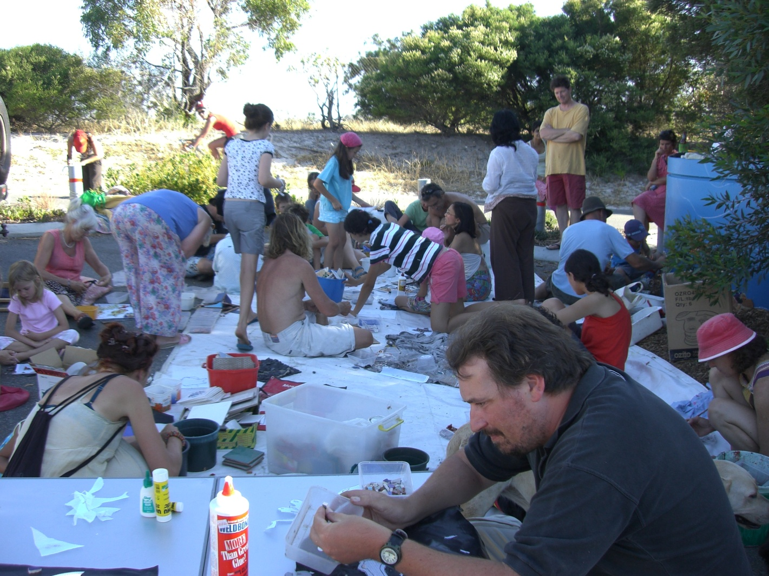
Taking Action
Notes:
The biggest part of LS for us was the way it encouraged us to change things about the way we operated in the world.
Some of the changes were little, some significant.
Great to be part of a supportive group to do that in!

Slide 31
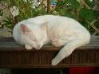
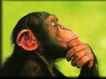
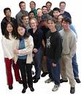
Taking Action some brain Science
3.5% in cats
17% in chimps
29% in humans
Notes:
What is it – the Prefrontal cortex – responsible for reasoning and forward planning
The human mind, like no other, has the ability to create different scenarios and plot a course towards an envisioned future.
So – we have the brains for long term planning in regards to our environment and sustainability

Slide 32
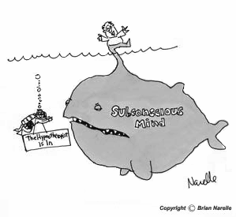
Taking Action – Your Subconscious
Notes:
Most of the work that our brains do is behind the scenes
And there are some useful things to know
Our subconscious believes everything as fact (eg dream, fears etc)
It takes the language you use literally (I am stupid, I will try to . . .)
It takes direction from the conscious mind
Works on repetition and reinforcement

Slide 33

Taking Action – some tools
Goal setting Positive thoughts Visualisations
Notes:
Given what we just learnt
Basically some good tools are
Goal setting (use precortex to plan for the future)
Positive language, affirmations and people (give eg of walking on the beach – touching rock and thinking three things to be grateful for)
Visualisations – trick your brain into seeing what you want

Slide 34

Taking Action - Visualise
Where would you like to be in five years time?
Notes:
(This might be one for homework if not time)
Where would you like to be in five years time?
What would you like to be doing, working on?
How do you want to live your life?
Imagine, draw or write
Take 3 minutes and do that now

Slide 35
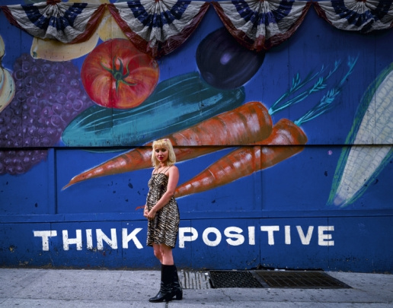
Taking Action – Positive Language
Notes:
If time get Tim to write up some negatives
I should , I could, I would, I want, I’ll do my best to, I’ll try
And get people to come up with alternatives
Alternatives
I can, I will, I have, I choose
Trick your subconscious - use positive words when you set goals

Slide 36
Taking Action Goal Setting
Specific
Positive
Realistic but challenging
Measurable
Flexible
ASK What?
Why?
When?
Where?
Who with?
How?
Notes:
Useful to think about
Goal and steps you need to make it happen
Why you want to achieve that goal
When you will achieve it by
Goal setting tips ( you will have this as a card)
Use as an example what I set re selling the car
Specific – are you clear on what you are working towards
Positive – reinforce what is good , rather than criticise bad
Challenging, yet achievable? Realistic? Small steps are good options
Measurable – will you know you’ve completed it
Flexible? – you may have to adjust what you are doing
And the amazing thing was that I recently was filing the transfer papers and noticed it was a month to the day from when I set the goal!

Slide 37

Taking Action - Sharing
Notes:
Tim is the master goal setter
He will share at this point

Slide 38
Tim’s Weekly Diary
Stream of consciousness
Things to do this week
Things to do this month
Three successes for the week
One affirmation

Slide 39
 | Friends and Family | Financial and Vocational | Emotional and Spiritual | Health Education Recreation
Three months
One year
Five year

Slide 40
What about You?
Your household ecological footprint
Where is my household – electricity, gas, water, car travel, air travel
Complete a five year visualisation exercise for yourself, your house, your street
MAKE A GOAL!

Slide 41

Think Pair Share – Your Goal What Why How When Where Who?

Slide 42

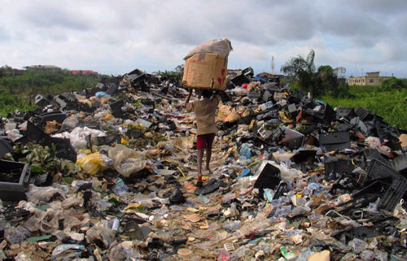
Next week

